Slide 1
Artificial Intelligence or Machine Intelligence
A branch of Computer Science named Artificial intelligence pursues creating the computers or machines as intelligent as human beings.

Slide 2
What is Artificial Intelligence?
According to the father of Artificial Intelligence, John McCarthy, it is “The science and engineering of making intelligent machines, especially intelligent computer programs”.
Artificial Intelligence is a way of making a computer, a computer-controlled robot, or a software think intelligently, in the similar manner the intelligent humans think.
AI is accomplished by studying how human brain thinks, and how humans learn, decide, and work while trying to solve a problem, and then using the outcomes of this study as a basis of developing intelligent software and systems.

Slide 3
Goals of AI
To Create Expert Systems
The systems which exhibit intelligent behavior, learn, demonstrate, explain, and advice its users.
To Implement Human Intelligence in Machines
Creating systems that understand, think, learn, and behave like humans.

Slide 4
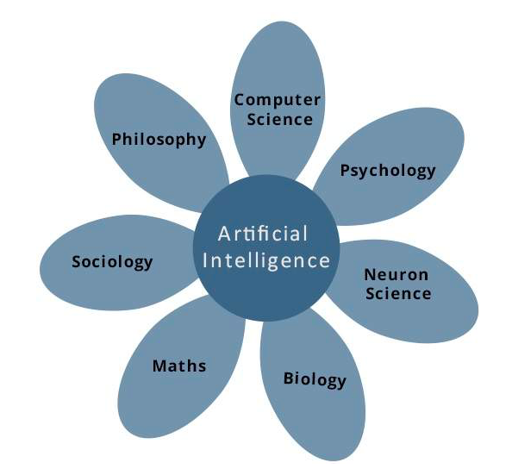
What Contributes to AI?
Artificial intelligence is a science and technology based on disciplines such as Computer Science, Biology, Psychology, Linguistics, Mathematics, and Engineering. A major thrust of AI is in the development of computer functions associated with human intelligence, such as reasoning, learning, and problem solving.

Slide 5
Programming Without and With AI
Programming Without AI
Programming With AI
A computer program without AI can answer the specific questions it is meant to solve
Modification in the program leads to change in its structure.
Modification is not quick and easy. It may lead to affecting the program adversely.
A computer program with AI can answer the generic questions it is meant to solve.
AI programs can absorb new modifications by putting highly independent pieces of information together. Hence you can modify even a minute piece of information of program without affecting its structure.
Quick and Easy program modification.

Slide 6
What is AI Technique?
In the real world, the knowledge has some unwelcomed properties are like
Its volume is huge, next to unimaginable.
It is not well-organized or well-formatted.
It keeps changing constantly.

Slide 7
AI Technique is a manner to organize and use the knowledge efficiently in such a way that
It should be perceivable by the people who provide it.
It should be easily modifiable to correct errors.
It should be useful in many situations though it is incomplete or inaccurate.
AI techniques elevate the speed of execution of the complex program it is equipped with.

Slide 8
Applications of AI
AI has been dominant in various fields such as
Gaming
Natural Language Processing
Expert Systems
Vision Systems
Speech Recognition
Handwriting Recognition
Intelligent Robots

Slide 9
Gaming: - AI plays crucial role in strategic games such as chess, poker, tic-tac-toe, etc., where machine can think of large number of possible positions based on heuristic knowledge.
Natural Language Processing: It is possible to interact with the computer that understands natural language spoken by humans.
Expert Systems: There are some applications which integrate machine, software, and special information to impart reasoning and advising. They provide explanation and advice to the users.
Vision Systems: These systems understand, interpret, and comprehend visual input on the computer. For example,
A spying aero plane takes photographs, which are used to figure out spatial information or map of the areas.
Doctors use clinical expert system to diagnose the patient.
Police use computer software that can recognize the face of criminal with the stored portrait made by forensic artist.

Slide 10
Speech Recognition: Some intelligent systems are capable of hearing and comprehending the language in terms of sentences and their meanings while a human talks to it. It can handle different accents, slang words, noise in the background, change in human’s noise due to cold, etc.
Handwriting Recognition: The handwriting recognition software reads the text written on paper by a pen or on screen by a stylus. It can recognize the shapes of the letters and convert it into editable text.
Intelligent Robots: Robots are able to perform the tasks given by a human. They have sensors to detect physical data from the real world such as light, heat, temperature, movement, sound, bump, and pressure. They have efficient processors, multiple sensors and huge memory, to exhibit intelligence. In addition, they are capable of learning from their mistakes and they can adapt to the new environment.

Slide 11
What is Intelligence?
The ability of a system to calculate, reason, perceive relationships and analogies, learn from experience, store and retrieve information from memory, solve problems, comprehend complex ideas, use natural language fluently, classify, generalize, and adapt new situations.

Slide 12
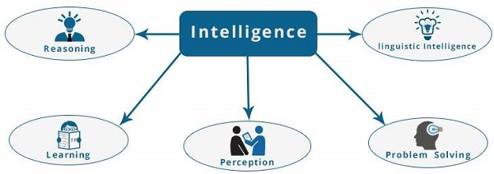
What is Intelligence Composed of?
Reasoning, Learning, Problem Solving, Perception, Linguistic Intelligence

Slide 13
Difference between Human and Machine Intelligence
Humans perceive by patterns whereas the machines perceive by set of rules and data.
Humans store and recall information by patterns, machines do it by searching algorithms. For example, the number 40404040 is easy to remember, store, and recall as its pattern is simple.
Humans can figure out the complete object even if some part of it is missing or distorted; whereas the machines cannot do it correctly.

Slide 14
Speech and Voice Recognition
Speech Recognition
Voice Recognition
The speech recognition aims at understanding and comprehending WHAT was spoken.
It is used in hand-free computing, map, or menu navigation.
Machine does not need training for Speech Recognition as it is not speaker dependent.
Speaker independent Speech Recognition systems are difficult to develop.
The objective of voice recognition is to recognize WHO is speaking.
It is used to identify a person by analyzing its tone, voice pitch, and accent, etc.
This recognition system needs training as it is person oriented.
Speaker dependent Speech Recognition systems are comparatively easy to develop.

Slide 15
Working of Speech and Voice Recognition Systems
The user input spoken at a microphone goes to sound card of the system. The converter turns the analog signal into equivalent digital signal for the speech processing. The database is used to compare the sound patterns to recognize the words. Finally, a reverse feedback is given to the database.
This source-language text becomes input to the Translation Engine, which converts it to the target language text. They are supported with interactive GUI, large database of vocabulary, etc.

